Slide 1
Ocean Worlds Exploration
Jonathan I. Lunine
67th IAC held in Guadalajara, Mexico, 26 September 2016

Slide 2
Introduction
What are ocean worlds? (Earth, Encladus, Titan, Europa, Triton)
Concept Similar to Rouge Planets. Life beyond the Goldilock Zone.
About exploration of the rocky and icy moons of the giant planets.
Tidal heating in Rouge Planets/Icy moons. Similar effect the moon does to our home Planet(Earth).
Suddenly took interest. Was unknown till 1980’s.
Not a Story or derived from theoretical studies or speculations.
Stong Evidence provided by the Voyagers 1 and 2, Cassini, Huygens Probe, New Horizon.
Why do we care(Motive?)? Search for Life. HydroThermal Vents on Earth.
Summaries the Strong Evidence with focus on three objects of our solar system.
Describe what we know and how we know it.
Shed light on prospects for determining more about their suitability for life and testing whether life is actually present.
Robust Search? Needs a dedicated program for selected ones.

Slide 3
Ocean Worlds: Which bodies and why?
Ocean Relics (Mars,Ceres). (brief)
Jovian Moons. (Compherensive)
Saturnian Moons. (Compherensive)
Kuiper Belt Objects(Pluto,Cheron). (brief)

Slide 4
Jovian Moons.
Three of four shows the evidence. But, the most promising is Europa.
Density of Europa- Most made of rocks. 100-200km deep oceans.
Moment of Inertia. (tectonic plates on earth.)
The surface keeps reshaping due to this.
Surface of Europa contrast to many of the moons of the solar system including our own moon, shows few craters.
Galileo spectral measurements of the surface were noisy because of the intense radiation environment.
The most compelling evidence for an ocean on Europa: magnetometer measurements.
Should observed deformations in the geometry of the Jovian magnetic field consistent with the movement of a conducting body relative to the field.
What observed were perturbations to the field that could be fitted to the volume and conductivity of the conducting layer.
Conclusion: Layer of liquid water(Silicate rich) must be within kilometers of the surface with an electrical conductivity.
Ocean is not sandwiched between low and high-pressure ice phases.
The base of the ocean is at the top of the silicate interior of Europa.
So why is it interesting? Hydrothermal Systems.

Slide 5
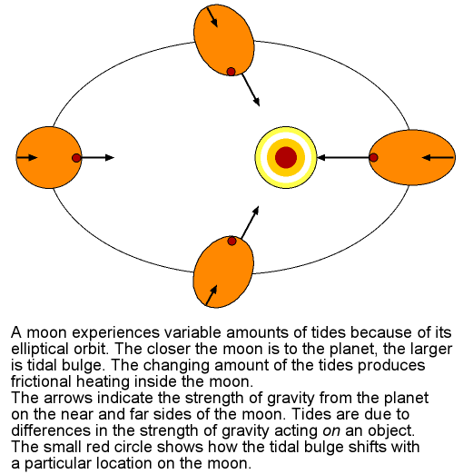
Jovian Moons.
But what caused the oceans to form underneath the icy crust?
Decay of radioactive elements in silicates(possibility), Geothermal Activities. Yes, but not sufficient.
Main reason: Juipter’s very strong Gravitational pull and Europa’s eliptical orbit. Tidal dissipation.
Similar is true for Callisto and Ganymede

Slide 6
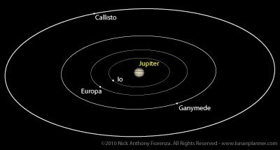
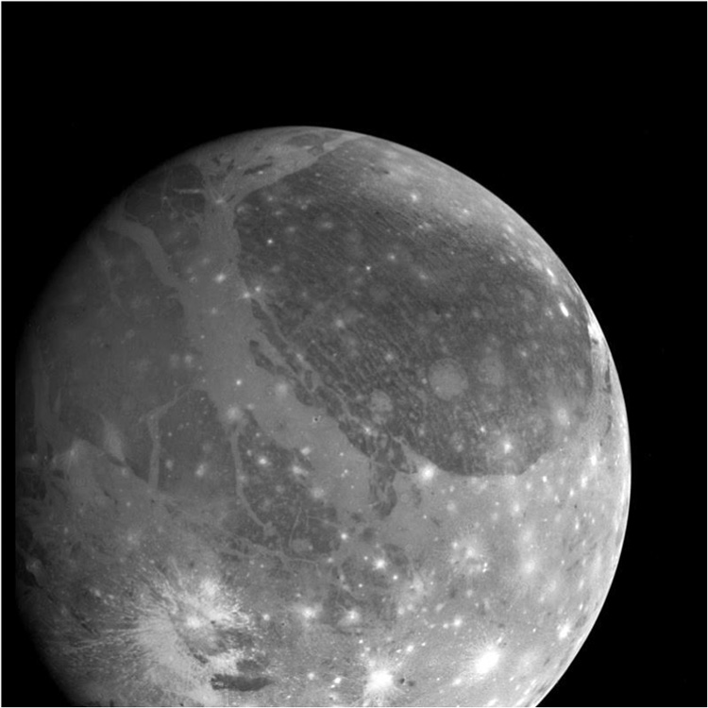
Jovian Moons.
But both Ganymede and Callisto have surfaces dominated by impact craters.
Geologic activity seems very ancient on boths surface.
Ancient craters requires thick, cold crusts, so that their oceans are likely deep below the surface—perhaps 100 km or more
Why is it so? There distance from jupiter. Larger it is less the pull and lesser the tidal dissipation.
Their oceans are likely sandwiched between layers of ice above and below, making contact with the underlying silicate (thought to be important for life) unlikely.

Slide 7
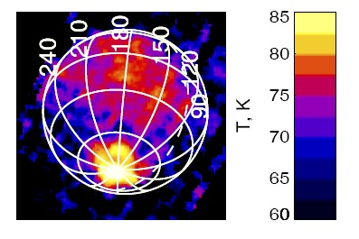
Saturnian Moons (Enceladus)
Evidence for oceans on Enceladus: Magnetic Field perturbation, infrared heat radiation detection and direct sampling.
Pumes of gas and ice(geysers) emanating from the south polar region collected by Cassini.
However this itself does not imply subsurface oceans.
Some barrier bigger than Enceladus itself was perturbing Saturn's magnetic field.
Mapping of infrared heat radiation from the polar region by the CIRS instrument (As shown in figure).
Heat was concentrated along prominent fractures, dubbed "tiger stripes", that were seen by Cassini's cameras.
The fractures seemed to be at least 130 degrees Fahrenheit warmer than their surroundings.
These temperatures were too high to be explained by solar heating of the surface: an internal heat source was needed.
Density of Enceladus(Lower compared to its volume). Implies Ice and rock mix.
More likely that like Europa the silicates lie beneath the water ice crust.

Slide 8
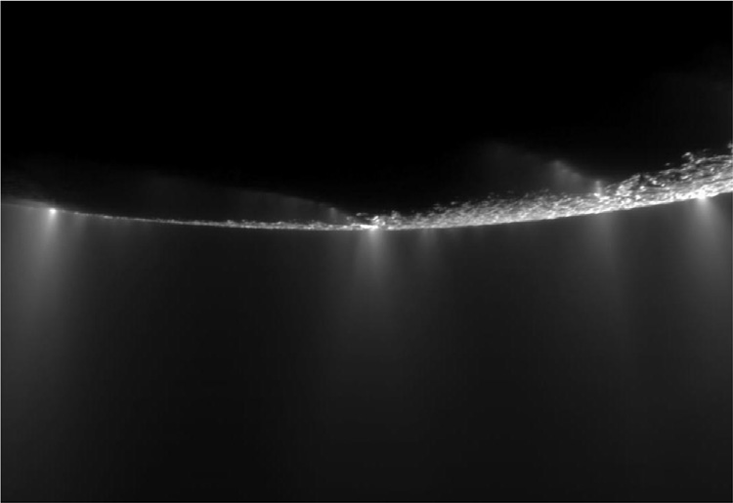
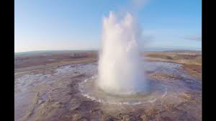
Saturnian Moons (Enceladus)
Cassini's ultraviolet spectrometer detected a cloud of water vapor over the south pole.
Onboard mass spectrometer was able to analyze the gas composition directly as the spacecraft flew through the cloud.
Reason for this subsurface oceans and tidal heating?
Enceladus is heated by the continual distortion of its shape by Saturn's gravity as the moon orbits Saturn in its slightly eccentric orbit.

Slide 9
Saturnian Moons (Titan )
Gold Mine for the Planetery Scientists

Slide 10
Saturnian Moons (Titan )

Slide 11
Saturnian Moons (Titan )

